Slide 1


Slide 2
CO-FOUNDERS:
Kesava Karri
Ankush Bosi
Ramesh Tripuraneni
Rahul Katamneni
Hardhika Venkatesan
TARGET MARKET:
Every individual and all websites related to medical field
VALUE PROPOSITIONS:
We will be using the twitter API to get the posts related to COVID-19 from users and then we will be performing sentiment analysis on these collected posts to get the general idea of how every individual is affected by the covid crisis and how they are responding.

Slide 3
THE PAIN WE ARE ADDRESSING
The records published by government or media are not necessarily need to be true.
inadequate accuracy and performance in sentiment analysis
Individual response over certain region
People are afraid to travel because of covid in that region
Event organisation

Slide 4
FIXING THE PROBLEM WITH AI OR COMPUTER TECHNIQUES
Twitter has always been a platform where people come together to put forth their opinions about issues.
Using ML to filter the raw data from twitter API.
The current global concern is COVID-19 and this has led to a tremendous uproar of tweets relating to COVID-19.
The large amounts of tweets produced definitely provide us the opportunity to analyze the tweets for all possible information - from people's activity and involvement to how the people are emotionally affected by the pandemic.

Slide 5
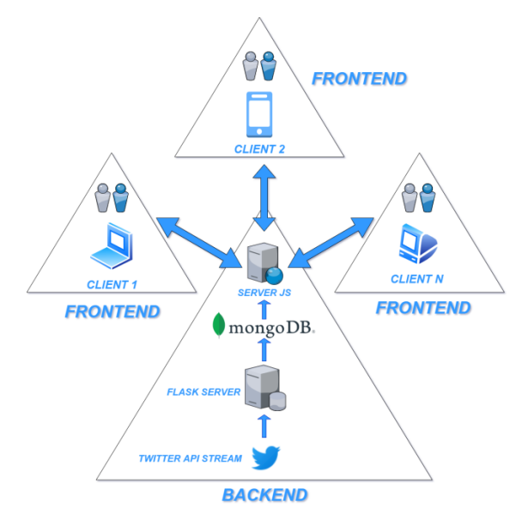
CONCEPT AND JUSTIFICATION
We will be using the twitter API to get the posts related to COVID-19 from individuals and then we will be performing sentiment analysis on these collected posts to get the general idea of how individuals are affected by the crisis and how they are responding.

Slide 6
CURRENT MARKET AND FUTURE IMPLICATIONS OF THE APPLICATIONS
The competitors are Rapid miner, Confirmit, IBM Watson Studio
Different social networking sites
Other than covid we can also work on various threats

Slide 7
VALUE PROPOSITION
Our goal is to exploit the tweet data and create a dashboard that will help us visualize all the analysis done on the tweet data like sentimental analysis, location heat maps, activity vs time graphs etc.
This will help us gain insights regarding how well the people are coping with the current pandemic.
This project aims to classify tweets based on emotions, cluster tweets based on location and analyze people's activity with respect to time and then generate intuitive visual representation of the data.

Slide 8
BUSINESS MODEL & MARKETING STRATEGIES
Social media marketing – LinkedIn, Instagram ads, Google ads
Monetization
Developing dedicated app for iOS and Android in future.

Slide 9
TEAM EXPERTISE
Kesava Karri – Full Stack Web Developer
Ankush Bosi – Cloud Architect
Ramesh Tripuraneni – Marketing Specialist & Backend
Rahul Katamneni – Front End Developer
Hardhika Venkatesan – NLP Engineer

Slide 10
PLAN FOR DESIGN, DEVELOPMENT, TECHNICAL VALIDATION, MARKET-ENTRY AND SCALE-UP
Planning to design an intuitive dashboard
Data fetching
data pre-processing
creating backend, designing frontend
Deployment
We’re planning to develop a web application

Slide 11
DEVELOPMENT AND COMMUNICATION TOOLS
Code development & management will be done using GitHub.
Microsoft Teams will be used for team collaboration, communication and team meetings purposes.

